Slide 1

Vision-Language-Action Integration for Robotic Chess Piece Manipulation
ROBO 755 Cognitive Robotics
Aamna Alshehhi 100062675
Presented to: Prof. Jorge Dias
Fall 2025
Notes:
Hello, my name is Aamna Alshehhi, and today I’ll present my project on Vision–Language–Action integration for robotic chess manipulation.

Slide 2
Overview & Objectives
01

Slide 3

Project Overview
This project presents a complete cognitive-robotics pipeline integrating vision, language, and action for autonomous object manipulation in a simulated environment.
YOLO-Based Perception
Language Parsing
Advanced YOLOv8 model identifies six chess pieces in real-time using CoppeliaSim.
Interprets human commands for instruction understanding.
Closed-Loop Action
Robotic pick-and-place execution via inverse-kinematics control.
Notes:
This project builds a complete cognitive-robotics pipeline that links perception, language, and action inside CoppeliaSim. First, a YOLOv8 model detects and classifies six chess pieces directly from the vision sensor. Then, a lightweight language parser converts simple human instructions into structured commands. Finally, the robot executes closed-loop pick-and-place motions using inverse kinematics. Together, these components demonstrate an end-to-end vision-language-action system for object manipulation.

Slide 4

Project Objectives
To design and implement a cognitively enabled robotic system for object manipulation in unstructured environments.
Develop a robust vision module for object detection, localization, and classification using YOLO.
Implement probabilistic reasoning for uncertainty-aware object selection and decision-making.
Design an autonomous manipulation pipeline for reliable pick-and-place execution.
Enable cognitive task execution through interpretation of high-level language commands.
Validate the full system through end-to-end simulations in CoppeliaSim.
Notes:
These objectives outline the key capabilities targeted in this project. The system aims to build a robust vision module for detecting and localizing chess pieces using YOLO. It also incorporates probabilistic reasoning to support reliable object selection under uncertainty. Another objective is to design an autonomous manipulation pipeline capable of consistent pick-and-place execution. Additionally, the system seeks to interpret high-level language commands for cognitive task execution. And overall, the full pipeline is intended to be validated through end-to-end simulations in CoppeliaSim.

Slide 5
Methodology and Implementation
02

Slide 6
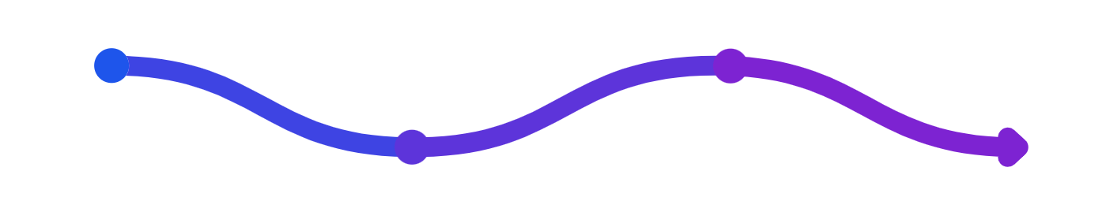
The Observe–Reason–Act Loop
The system integrates multimodal perception, language-driven reasoning, and motion synthesis.
Perception
Action
YOLOv8 deep‑learning vision for real‑time object detection and sensory grounding.
Inverse kinematics and gripper control to synthesize precise robotic motions
Reasoning
Closed‑Loop Integration
Natural language interpretation that grounds symbolic commands to sensory data
Tightly coupled multimodal feedback for robust execution under uncertainty
Notes:
This slide summarizes the core methodology used throughout the system. The pipeline follows an Observe–Reason–Act structure, where perception, reasoning, and action are tightly integrated. First, the perception layer uses YOLOv8 to detect chess pieces in real time and ground the robot’s sensory understanding. Next, the reasoning layer interprets natural-language instructions and maps them to symbolic tasks tied to the perceived scene. Finally, the action layer uses inverse kinematics and gripper control to generate precise motions, all reinforced by closed-loop feedback for robustness under uncertainty. This loop forms the foundation for the entire VLA integration.

Slide 7

Vision Module: Colored Cubes Detection Pipeline
HSV Color Filtering
Segment image by color in HSV space to isolate cube hues under controlled lighting.
Morphological Cleaning
Apply opening/closing to remove noise and fill small gaps, improving mask quality.
Contour Extraction
Find contours on the cleaned mask to localize candidate shapes for cubes.
Geometric Validation
Validate contours by shape/area criteria to confirm cube detections reliably.
Real-time Output
Pipeline runs at approximately 30 Hz, providing a practical baseline for perception–action.
Notes:
This slide outlines the classical vision pipeline used for detecting colored cubes. The process starts with HSV color filtering, which isolates each cube’s hue under consistent lighting. Morphological operations are then applied to clean the mask and remove noise. Next, contour extraction is used to identify candidate regions that match cube-like shapes. These contours are validated using geometric criteria such as area and aspect ratio to ensure reliable detections. Overall, the pipeline runs at around 30 Hz, which provides real-time performance for perception–action tasks.

Slide 8





Advanced YOLOv8 Perception for Chess Pieces
Dataset: synthetically generated & annotated chess pieces in CoppeliaSim
Model: YOLOv8 detector trained on synthetic data for six classes
Outputs: bounding boxes, confidence scores, object centroids
Runtime: real‑time frame streaming into reasoning module
Benefits: robust to viewpoint/pose variation; greater semantic depth and scalability vs classical vision
Notes:
This slide summarizes the YOLOv8 perception module. The detector is trained on a synthetically generated dataset of chess pieces collected from CoppeliaSim. The model learns six classes and outputs bounding boxes, confidence scores, and centroid locations for each piece. These detections are streamed in real time into the reasoning module, allowing the robot to maintain an updated view of the scene. Compared to classical filtering pipelines, YOLOv8 provides robustness to viewpoint changes and offers richer semantic information, making it more scalable for manipulation tasks.

Slide 9

Probabilistic Reasoning: Uncertainty Aware Perception
Probabilistic grounding of perception
Interpret YOLO confidence scores as posterior probabilities to reason under uncertainty.
Confidence filtering to avoid errors
Apply a 0.6 confidence threshold to discard low-confidence detections before action.
Highest-confidence selection for grounding
When multiple matches exist, pick the detection with highest confidence to map perception to action.
Outcome: robust autonomous manipulation
Uncertainty-aware inference reduces erroneous actions in cognitive robotics.
Notes:
This slide shows how uncertainty is handled in the perception pipeline. The system interprets YOLO confidence scores as probabilistic estimates of correctness, allowing reasoning under uncertainty. A confidence threshold is applied to filter out unreliable detections and avoid triggering incorrect actions. If multiple candidate detections exist, the system selects the one with the highest confidence to ground the perceived object. By integrating these simple probabilistic steps, the overall manipulation process becomes more robust and less sensitive to perception noise.

Slide 10
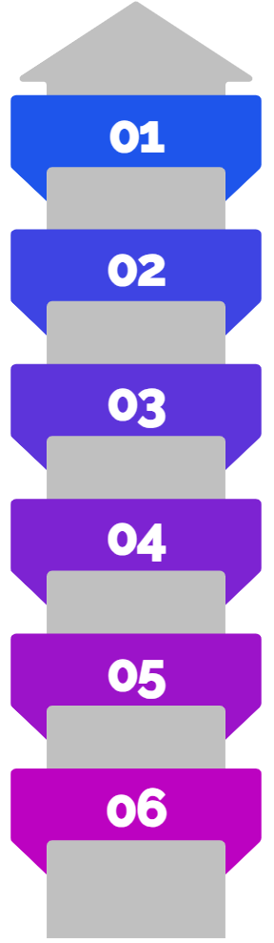
Language-Conditioned Reasoning for Robotic Commands
Language Parsing
Interpret command like “put the queen in the left bin” and extract object type and destination
Semantic Grounding
Link symbolic labels to sensory concepts; filter perception results by extracted parameters
Perception Filtering
Use YOLO-based detection to find candidate objects matching object type
Destination Resolution
Resolve spatial target (e.g., left bin) from language to world coordinates
Action Mapping
Translate grounded intent into robot actions: grasp, move, attach/release in CoppeliaSim
Execution & Verification
Execute motion; verify outcome via perception and release by gripper
01
02
03
Approach
Grasp
Lift
Move end-effector above target.
Descend, close gripper.
Raise to safe transport height.
04
05
Transfer
Release
Move to receiving bin.
Open gripper, retract.
Notes:
The reasoning pipeline begins by parsing the natural-language instruction to extract the object type and destination. These symbolic elements are then grounded in the perceived scene by filtering YOLO detections that match the requested object. Next, the system resolves the destination—such as the left bin—by converting the linguistic reference into world coordinates. Once both the target object and destination are grounded, the intent is mapped into a sequence of robot actions like grasping, moving, and releasing in CoppeliaSim. Finally, the robot executes the motion and verifies the result through perception to ensure the command was completed correctly.

Slide 11

Pick-and-Place Control Pipeline
Target Acquisition
Use estimated 3D target position from perception to seed the IK plan
Approach
Generate incremental IK waypoints for smooth, collision-aware approach
Grasp
Execute final IK pose and trigger gripper binary close signal to secure object
Lift & Transfer
Follow IK trajectory for lift and transfer while monitoring sensory feedback
Release
Command gripper
binary open signal at target location to release object
Notes:
The pick-and-place pipeline begins by using the estimated 3D pose from perception to initialize the inverse-kinematics plan. The robot then approaches the object through incremental IK waypoints to ensure a smooth and collision-aware trajectory. At the final pose, the gripper closes with a binary command to secure the object. The system lifts and transfers the piece along a predefined IK path while monitoring feedback. Finally, the gripper opens at the target location to complete the release.

Slide 12
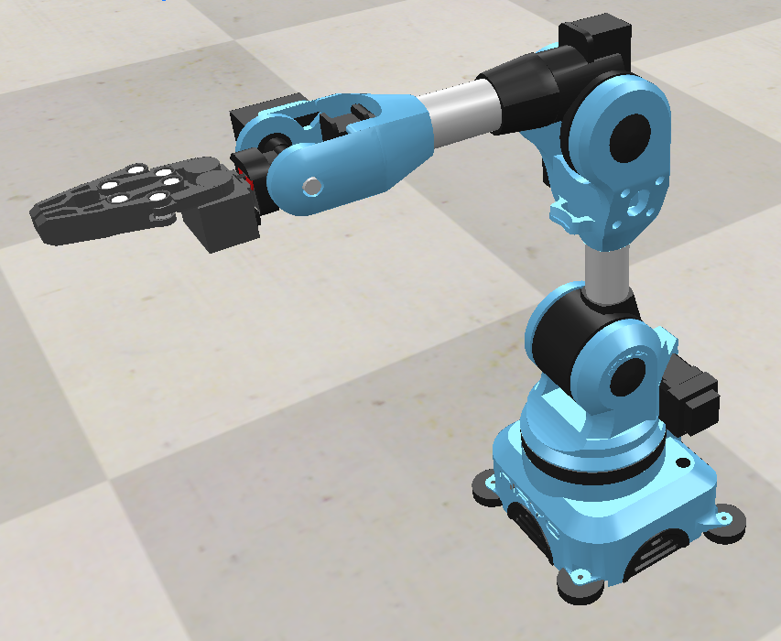
Robot Kinematics & Gripper Control Architecture
6-DoF Serial-Chain Arm: Articulated joints forming a serial kinematic chain; joint angles drive end-effector pose.
Inverse Kinematics (IK): Solve joint commands to reach target Cartesian positions; supports waypoint tracking.
IK-Driven Controller: Generates smooth trajectories; updates commands incrementally to track waypoints reliably.
Parallel-Jaw Gripper: Contact-based attachment mechanism enabling secure grasp and controlled release.
Integration Interface: Control pipeline linking FK/IK, controller, and gripper for reliable physical interaction.
Notes:
The manipulation system is built on a 6-DoF serial-chain arm, where joint rotations define the end-effector pose. Inverse kinematics is used to compute the joint angles required to reach target Cartesian positions and to support waypoint-based motion. An IK-driven controller then generates smooth trajectories, updating commands incrementally to track those waypoints reliably. The parallel-jaw gripper provides a simple but effective contact-based mechanism for grasping and releasing objects. All components are connected through an integration interface that links the FK/IK modules, motion controller, and gripper to ensure consistent physical interaction in simulation.

Slide 13
Results & Simulation
03

Slide 14
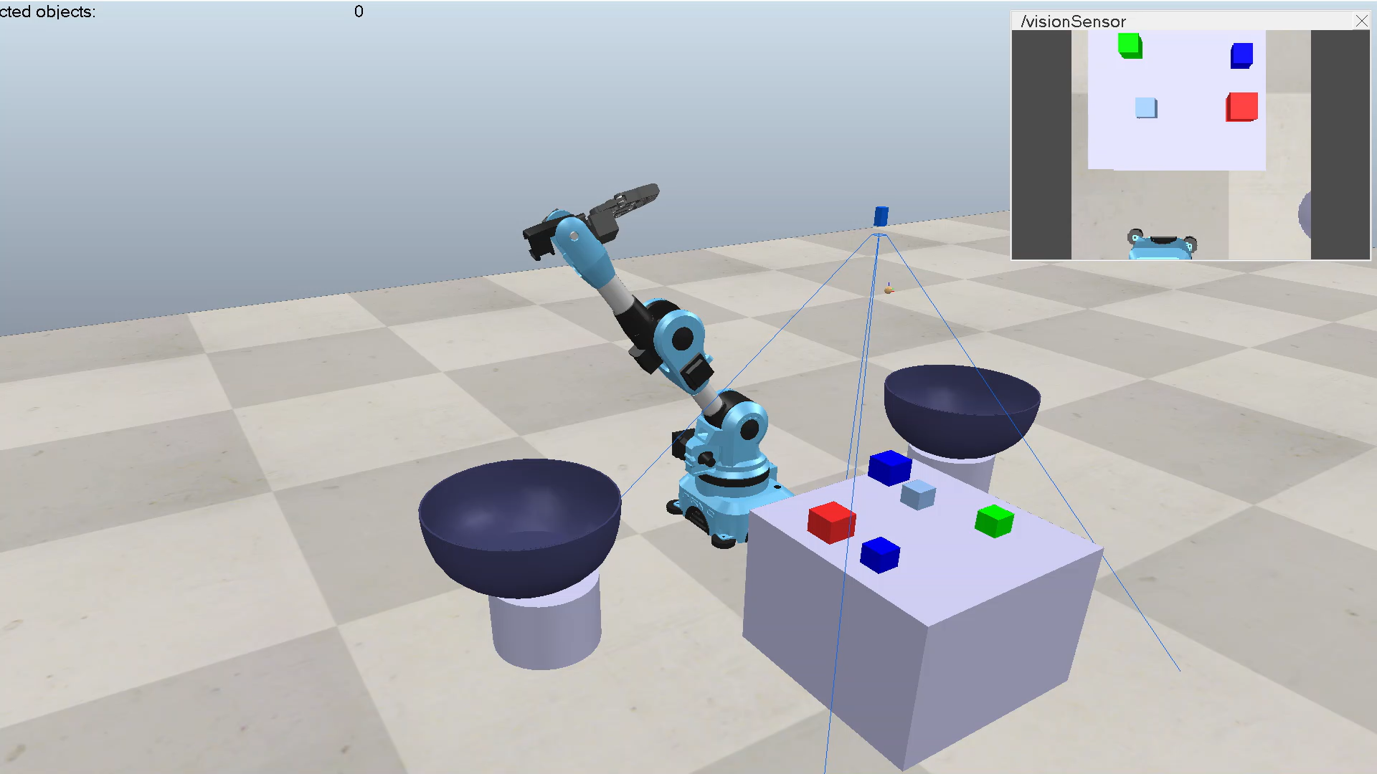
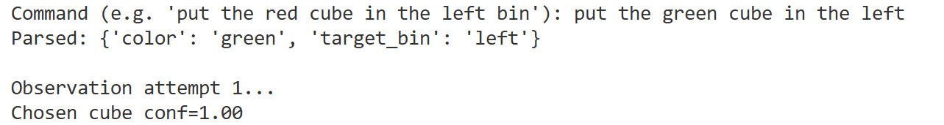
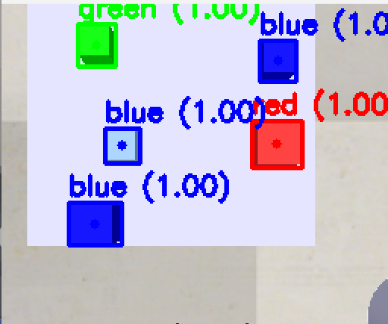
Colored Cubes Detection
Real-time HSV filtering validated as a robust baseline for simulated perception.
Tested on 10 frames with varied cube positions
Operates in real time (~30 Hz) with no false positives
Provides a robust baseline supporting transition to learning-based detectors
Notes:
The colored-cube detector uses HSV filtering as a fast and reliable perception baseline inside CoppeliaSim. Across multiple test frames with varied cube placements, the pipeline consistently detected all cubes with no false positives. It runs at around 30 Hz, making it suitable for real-time interaction. As shown in the video, the detector provides stable segmentation and clean bounding regions, which makes it a solid foundation before moving to learning-based methods like YOLO.

Slide 15
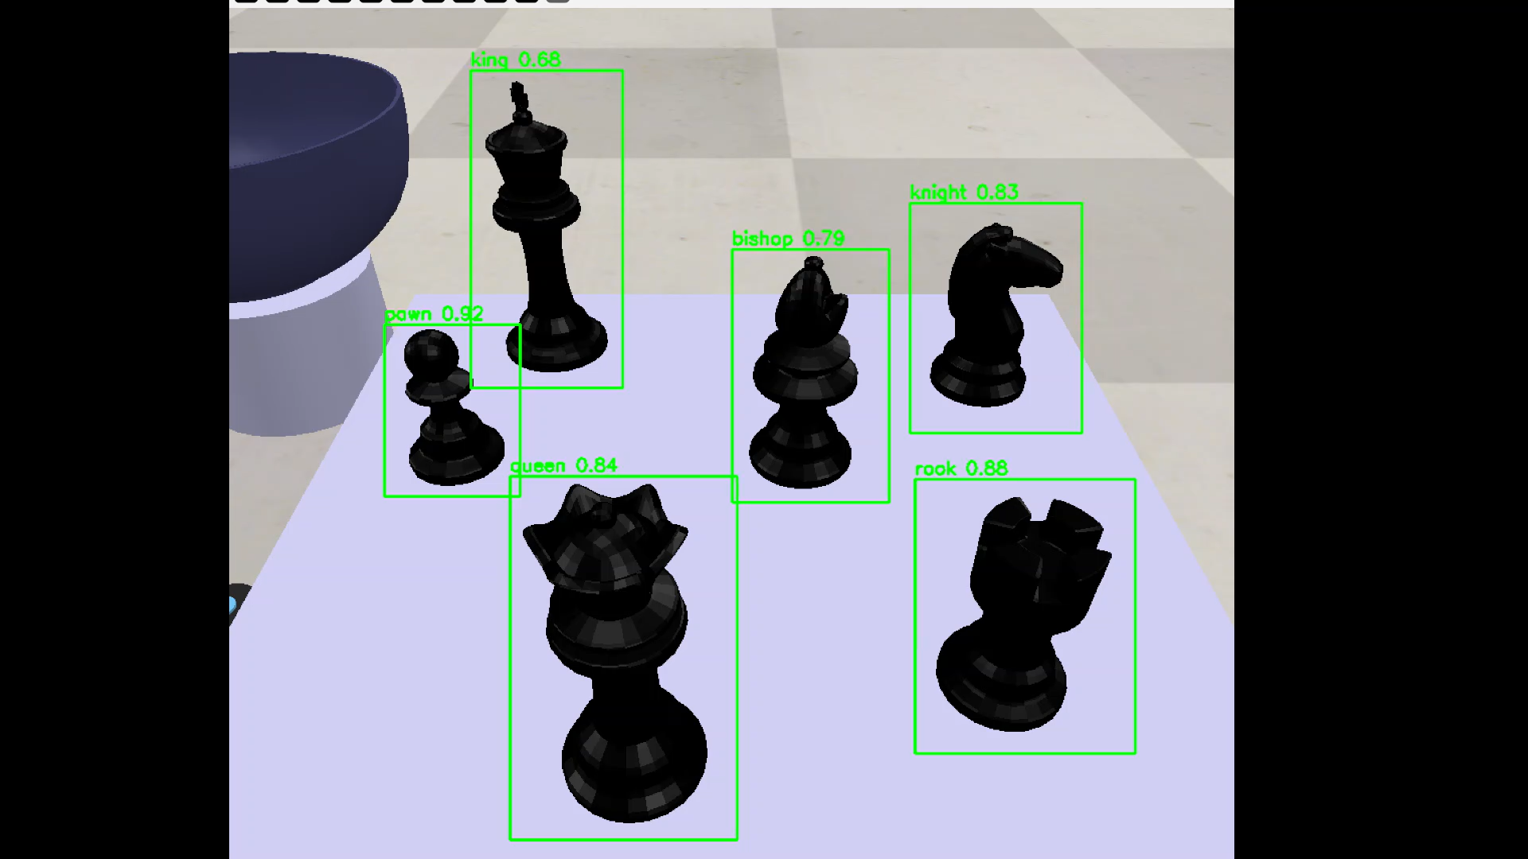
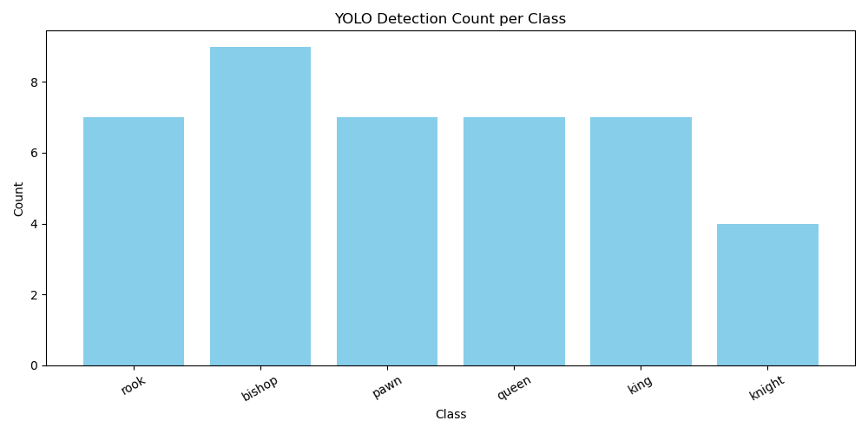
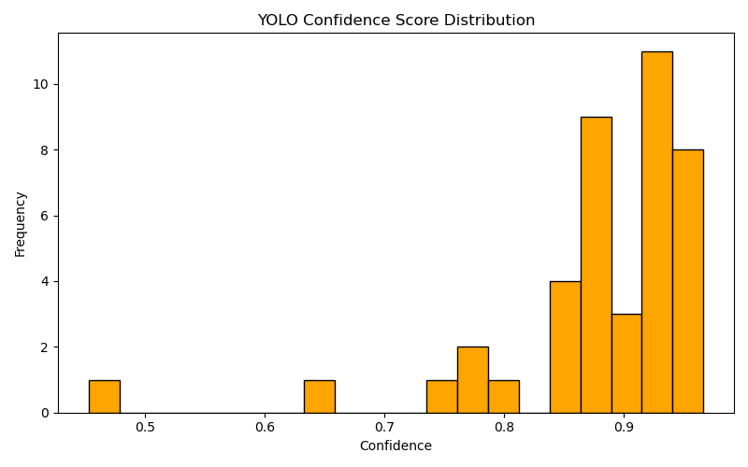
YOLO-Based Chess Piece Detection
Average confidence = 0.80 per piece class on the synthetic chess dataset.
Probabilistic module applies thresholding: actions triggered only when posterior confidence > 0.60
Confidence distributions stable under minor pose and viewpoint changes
Notes:
The YOLO-based detector performs reliably on the synthetic chess dataset, with an average confidence of around 0.80 across all six classes. A probabilistic threshold of 0.60 is applied so that actions are triggered only when detections are sufficiently certain. As shown in the plots, class counts remain balanced and confidence scores cluster in the high range, indicating stable performance under minor changes in pose and viewpoint. This level of consistency is enough to support downstream reasoning and manipulation in the simulated environment.

Slide 16
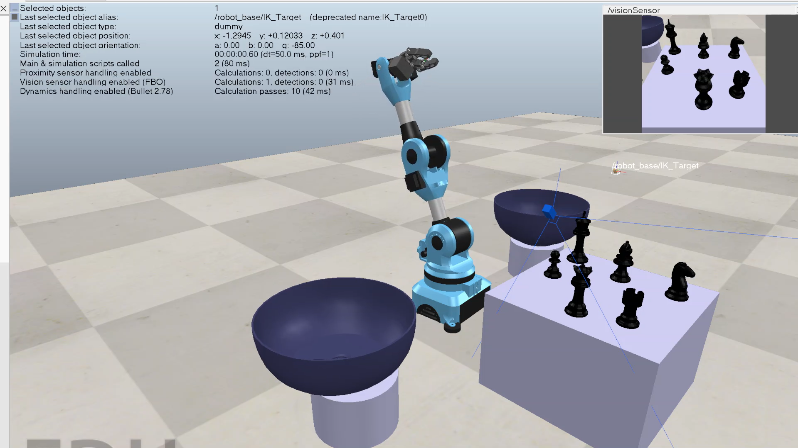
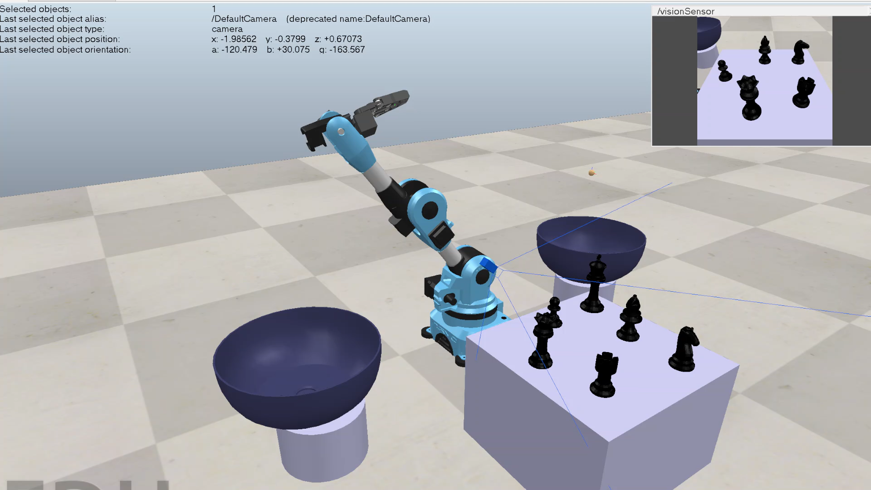
Robotic Manipulation Simulation
The overall execution success rate was 80%, with failures primarily due to edge-case occlusions or dynamic interactions
“Pick the queen and put it in the left bin.”
“Pick the king and put it in the right bin.”
Notes:
The full vision–language–action pipeline was validated through multiple manipulation trials in CoppeliaSim. Across all tests, the system achieved an overall success rate of about 80%. Most failures were linked to edge-case occlusions or small dynamic interactions during grasping. These two videos show examples of successful executions: one handling the command ‘pick the queen and place it in the left bin’, and the other executing ‘pick the king and place it in the right bin.’ Both showcase the full chain—from perception to reasoning to closed-loop pick-and-place action.

Slide 17
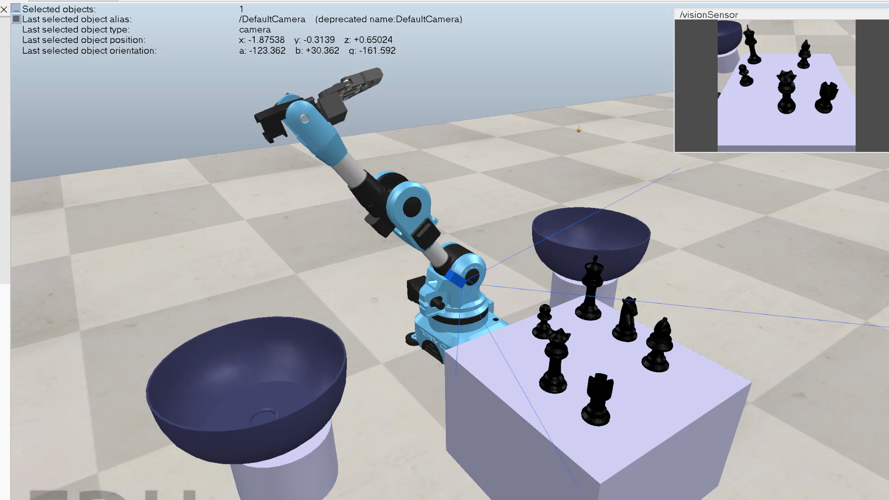
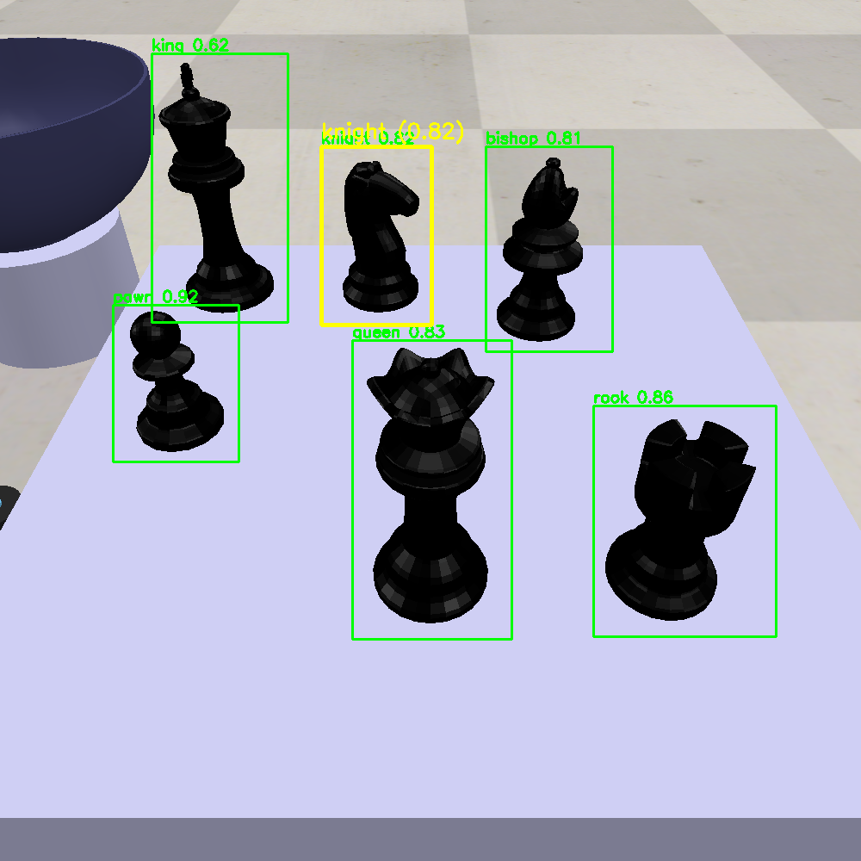
Robotic Manipulation Simulation
“Pick the knight and put it in the right bin.”
Notes:
This example shows another successful execution of a language-conditioned command. Here, the system interprets the instruction ‘pick the knight and put it in the right bin’. The YOLO detector identifies the knight with high confidence, the reasoning module resolves the target location, and the IK controller carries out the pick-and-place motion.

Slide 18
Conclusion & Future Work
04

Slide 19
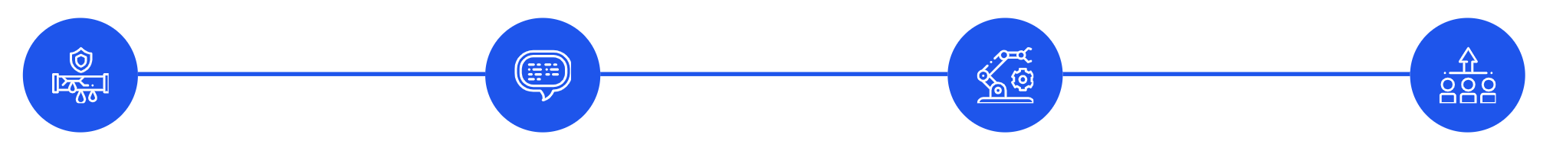
Conclusion
Integrated cognitive robotics pipeline
Real-time YOLO perception integrated with probabilistic reasoning to handle sensory uncertainty and drive decisions.
Language-grounded action
Semantics-based command grounding that connects natural language instructions to embodied vision–language–action behaviors.
Prototype with real-world intent
Simulation prototype designed to reflect requirements for service, logistics, and manufacturing robots operating under sensory uncertainty.
Foundation for deployment and scaling
Work lays groundwork for extending embodied systems toward practical deployment and multi-step task execution.
Notes:
This work demonstrates an integrated cognitive robotics pipeline that brings together real-time YOLO perception, probabilistic reasoning, and language-conditioned action. The system can interpret natural-language instructions and ground them in the perceived scene to produce meaningful, task-driven behavior. Although built in simulation, the prototype reflects real-world requirements for service and logistics robots operating under uncertainty.

Slide 20
Future Work
Multi-view sensing & depth reconstruction to improve perception robustness under occlusion
Adaptive controllers to replace fixed pick-and-place with optimization or reinforcement learning
Probabilistic state estimation, by integrating Bayesian filtering for reliable belief tracking
Expanded perception for clutter & dynamics, transformer-based or open-vocabulary detectors
Goal: deployable, general-purpose embodied vision language action robots for real-world tasks
Notes:
Several directions can extend this prototype toward more capable embodied systems. First, multi-view sensing and depth reconstruction would improve robustness under occlusion. The fixed pick-and-place routine can be replaced with adaptive or learned controllers that optimize trajectories. More reliable operation could be achieved through probabilistic state estimation, for example by integrating Bayesian filtering. Perception can also be expanded to handle clutter and dynamic scenes using transformer-based or open-vocabulary detectors. Ultimately, the goal is to move toward deployable, general-purpose robots that combine vision, language, and action for real-world tasks.

